Slide 1
Step detection in SEE: (DWT) Discrete wavelet transforms vs. (CNN) Convolutional neural networks
Previous method of step function fitting is not good:
the changing slopes.
The noise correlation is ignored.
Result:
Low-noise data >> DWT is good.
Noisy data >> CNN is more suitable but needs more computation cost.
DWT:
Step height = the mean value difference between the first two and the last two values in each step interval.

Slide 2
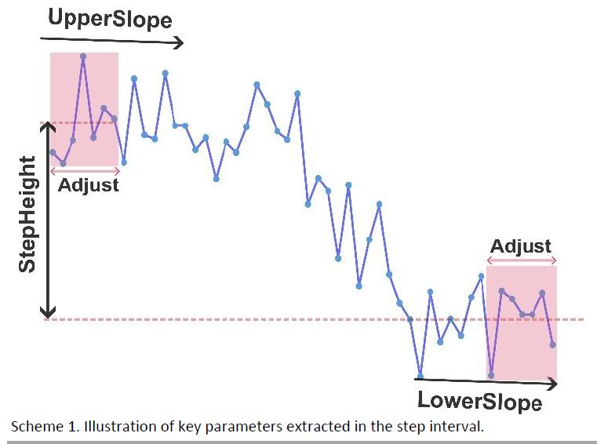
DWT:
Step height = the mean value difference between the first two and the last two values in each step interval.
It is important to note that the height threshold is a crucial parameter for step detection, as abrupt change can be determined only relative to the size of the signal. Depending on the set height threshold some steps might be excluded or noise can be included.
DWT is limited that it would identify any abrupt change as a step.

Slide 3
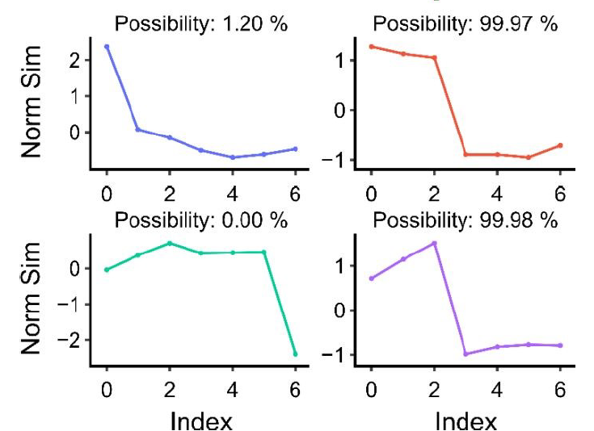
CNN:
A CNN can be thought of as a collection of filters. Each filter is a small matrix that performs a convolution operation on the output of the previous layer. These filters are trained to extract features from their input data. The results of these convolutions, which are the extracted features, then serve as the input for the next layer. This process is repeated layer by layer. Eventually, the network outputs a probability value, indicating the likelihood that the input data belongs to a certain class. The workflow for using CNN to detect step signals involves several additional procedures, which are outlined below.
the model predicts well the possibility of the signal being a step and, contrary to DWT, does not misassign an abrupt change to a step signal.
Model validation on random signals. The model detects the possibility of whether the signal is a step or not a step.

